Slide 1
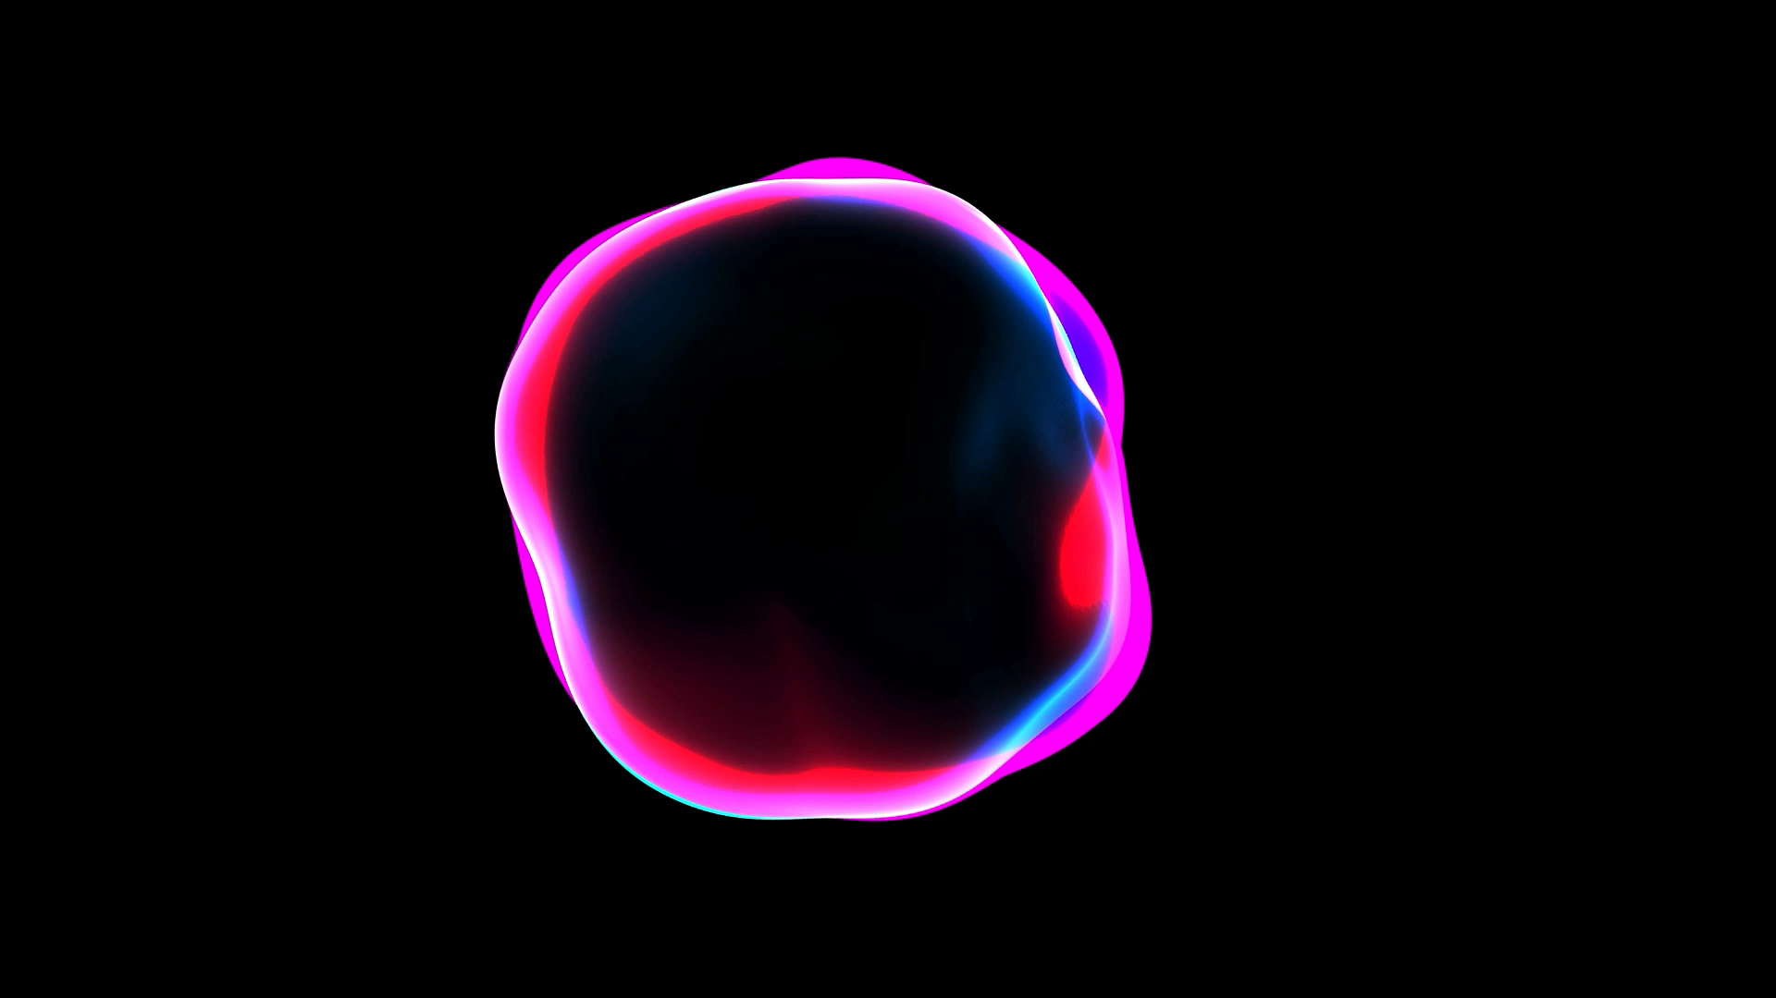
MRI Thermal Impacts
By Manish Kumar Sharma

Slide 2

Background
Magnetic Resonance Imaging (MRI)
Magnetic Resonance Imaging (MRI) are scanners that use static, gradient, electromagnetic field, and radiofrequency to produce high-quality anatomical images.
Commercially available for clinical use ranges from :
0.2 tesla(T) to 3 tesla (T)
Few research units operate above 3 T
Majority of scanners involved for general diagnostic purposes are 1.5 T in strength.

Slide 3
Background
Implants (medical device)
Active
A medical device that relies on electrical energy or any source of power other than directly generated by the human body or gravity
(AIMD)
Passive
An implant that can serve its function without the supply of any source of power other than directly generated by human body or gravity
(PMD)
Notes:
"active medical device which is intended to be totally or partially introduced, surgically or medically, into the human body or by medical intervention into a natural orifice, and which is intended to remain after the procedure”

Slide 4
Theory
MRI emits Electromagnetic Frequency (EF) at 64 MHz (1.5 T MRI) and 128 MHz (3.0 T MRI), which induces a strong electromagnetic field and causes heating of tissues.
During MRI, temperature increases were observed in merely biological bodies, with more dramatic effects observed in bodies bearing implants.
The entire situation becomes more drastic if the implant is conductive. In patients with conductive implants, the implant couples with these generated fields, resulting in local amplification of these E-fields and, as a result, the formation of local hotspots.

Slide 5
Problem
Typically, scanners are made to give anatomical views of biological tissues and not deal with conductive objects.
By no means can they detect any metallic device and can adjust the safety measures like changing the scanning parameters or rejecting the subject.
There has been a considerable gap where safety concerns need to be implemented to deal with this type of situation. Technologies like this are still far from realistic; until then, safety concerns need to be followed for patients with implants.

Slide 6
If we consider the physical interactions, the risk taken by a patient undergoing MRI with an implant can be categorized into basic four categories:
forces and torques exerted by the static magnetic field on ferromagnetic objects;
forces, also known as Lenz forces, and corresponding torques exerted by the static magnetic field on moving metallic objects.
Failure of an active device, such as a cardiac pacemaker, because of high EM fields in MRI, resulting in missing support for essential functions or possibly active damage due to erratic behavior;
local heating and tissue damage caused by currents created by time-varying RF and gradient fields in the implant.

Slide 7
Theory for Possible heating's during MRI:
Electromagnetic induction is the primary reason behind causing burns during MRI. This can be minimized by reducing the number of loops in the cable and keeping electrodes as close together as possible.
Electromagnetic Induction Heating
Time-varying gradient magnetic fields and radiofrequency electromagnetic fields used in MRI can generate voltages and currents in conductive materials. These circulating currents impel power loss by ohmic heating, called induction heating.
The major cause of thermal damage encountered during MRI has frequently been thought to be electromagnetic induction heating of monitoring wires. The formation of a loop in the monitor cable would increase the inductance of the circuit, resulting in bigger currents with increased cable heating.
An electromotive force (EMF) is created when magnetic induction flux changes in a fixed circuit. The EMF lasts as long as the flux changes. The induced EMF's magnitude is related to the flux change rate. The changing magnetic field induces eddy currents, which cause joule heating of the conducting specimen.

Slide 8

Theory for Possible heating's during MRI:
Heating in a Resonance Circuit
The maximum heating occurs when the circuit is in a resonant state, this heating is electromagnetic induction heating which also results in maximum current. When a conducting coil is kept under a time-varying magnetic field is equivalent to a circuit having inductance (L), a capacitance (C), a resistance (R), and an oscillating voltage at an angular frequency $ω$. Now the peak current in the circuit is denoted by ($ω$ =1/(L/C) ^1/2).
Thus, resonance occurs at the frequency where the inductance and capacitive impedances are equal and opposite, canceling each other perfectly. As a result, to tune a circuit, either the capacitance or the inductance may be changed until resonance occurs at a given frequency.

Slide 9
Theory for Possible heating's during MRI:
Heating due to Antenna Effect
When we think about the current in the whole cable, this wire can also perform as a radiofrequency (RF) wire antenna. These wires have more sensitivity towards the electric components than a magnetic component of the RF radiation. The maximum electric field density is localized at the tip of the antenna. This is the additional electric field induced by currents in the antenna.
When the antenna is about half a wavelength long, resonance occurs (half-wave dipole antenna). When resonance is reached, the electrical energy is limited to the local area of a certain antinode. As a result, the antennae's strongest electric field is near the tip.

Slide 10
MRI induced heating in Pacemaker
The induced current in pacemakers during an MRI depends on device position and lead pathway inside the body. In most cases studied, current intensities and resulting heating effects are very small. Though, in some conditions of anatomical arrangements, the induced heating can be very high in worst-case scenarios when the lead pathway is along the wall of the phantom.
The recent studies of 115 pacemaker patients who undergo MRI show no adverse effects, while 4 revealed significant injuries. This can be due to RF-related myocardial injury through the heating of tissues. There are chances of heating effect in several configurations matching the situation in the body.
Notes:
Implanted pulse generator (IPG) / pacemaker

Slide 11
MRI induced heating in Pacemaker
It has also been found that there has been minor heating in a relatively large number of device configurations of about 2.9 C with IPG.
When compared to IPG placement in the right pectoral area, the mean temperature elevation, and therefore averaged patient risk, was much lower when the IPG was implanted in the left pectoral region. In some anatomically acceptable configurations, cardiac pacemaker devices implanted in either the left or right pectoral area can produce substantial RF-related implant heating.

Slide 12
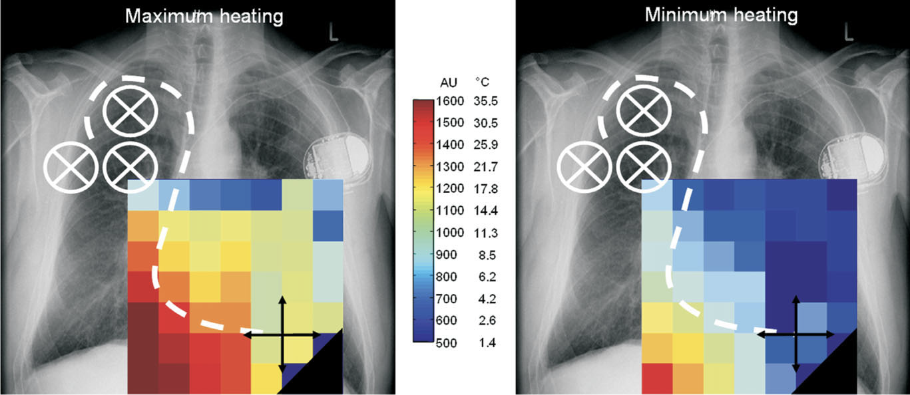
Right Pectoral Region
Notes:
Pacemaker lead heating of a single chamber system with the IPG in the right pectoral region dependent on the lead tip position.
Three IPG positions were investigated, with the associated lead paths covering the entire predetermined approximate cardiac volume. The
induced current intensity inside the implant was determined in each configuration and then converted to lead tip heating values as
described. Maximum (left) and minimum (right) implant heating is shown dependent on the lead tip position/lead pathway in the coronal
plane, summarizing the measurement results in different IPG positions (medial/lateral/superior) and lead tip positions (measurement surface
areas ventral/medial/dorsal).

Slide 13
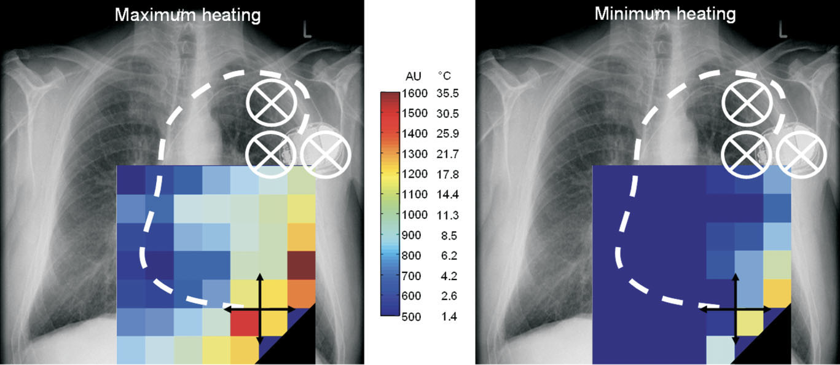
Left Pectoral Region

Slide 14
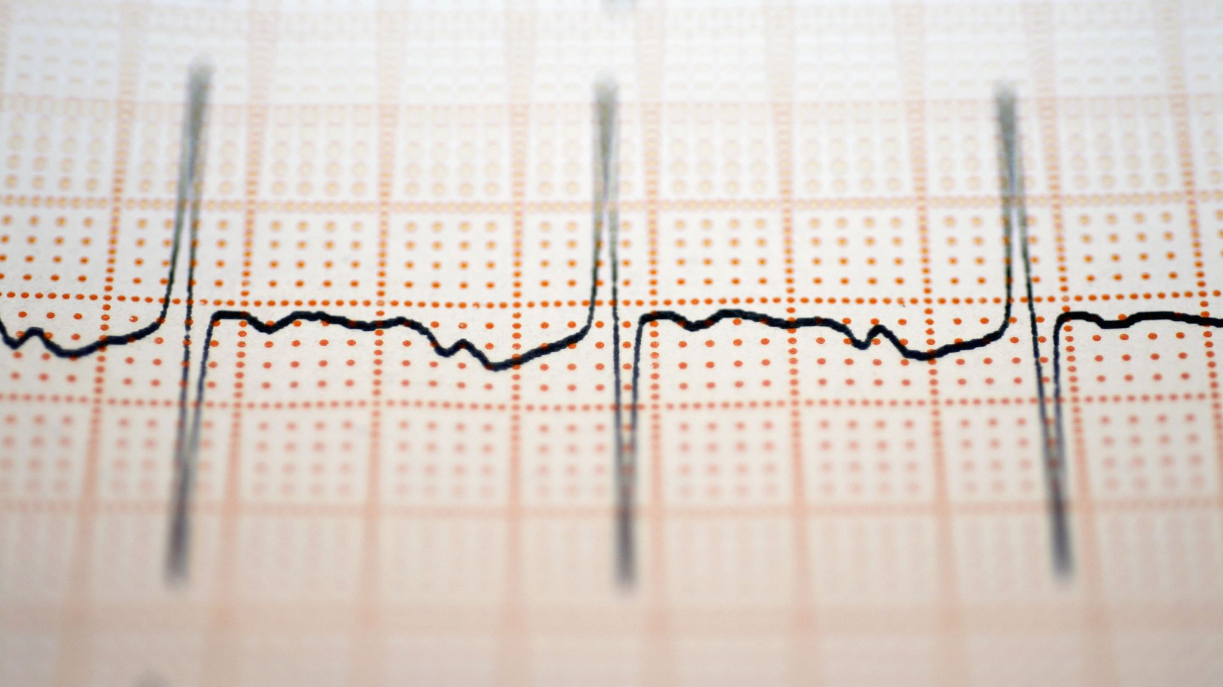
MRI induced heating in Pacemaker
Experimental research in this sector has yielded a wide range of results and indicated that numerous factors could influence the amount of heating created at the lead tip. One of these is the lead's structural parameters.
PM/ICD leads inside a human trunk simulator exposed to the RF field of a 1.5T MRI scanner.
A temperature variation of 2.1C to 15C was observed
A significant amount of heating was observed not Just at the tip but also at the ring (4.2C)
Active fix leads showed higher temp increase than passive fixed ones (4.7C vs 7.4C)
Notes:
Implanted pulse generator (IPG) / pacemaker

Slide 15
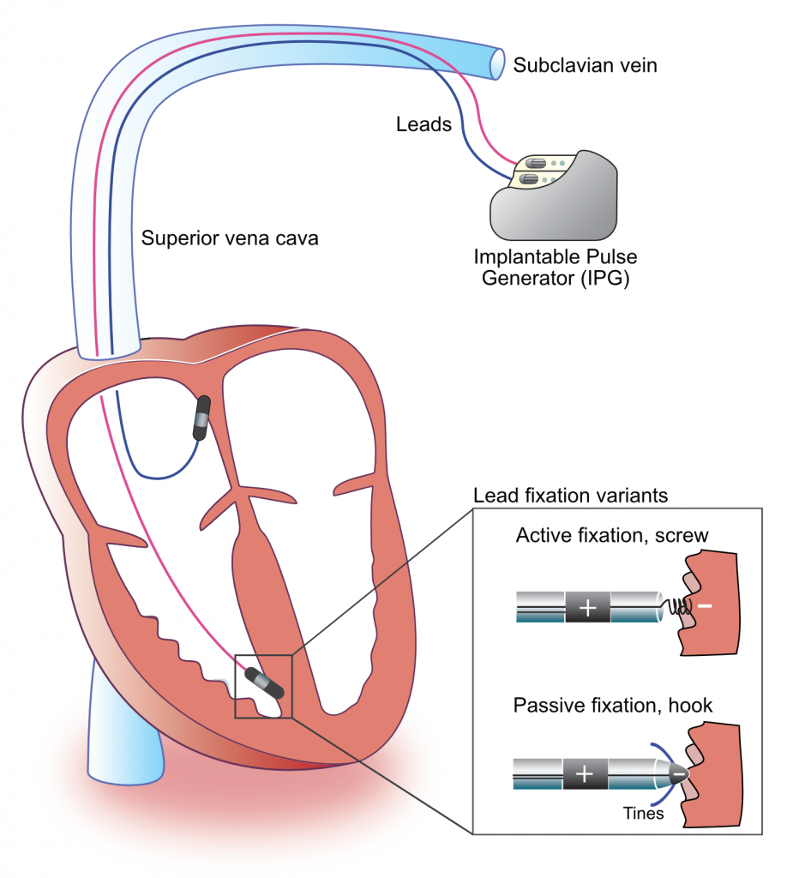
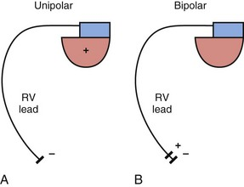
Unipolar lead and Bipolar Lead
Active fixation and passive fixation

Slide 16
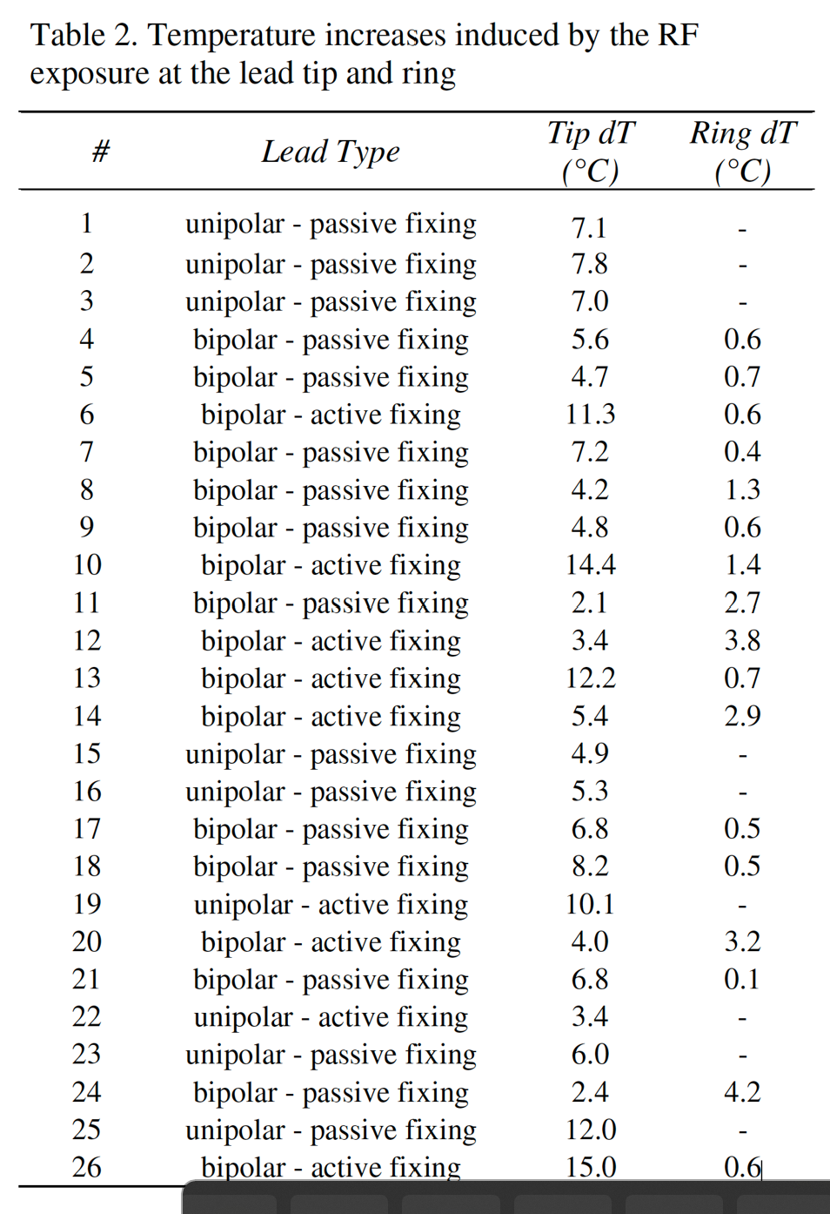
Observations
it was observed that at the implant tip, there were varying results, ranging from 2.1C up to 15C
A significant amount of heating was also observed at most of the ring of bipolar leads temperature changes from 0.1C to 4.2C

Slide 17
Observations
Temperature increase at the ring was reported for the bipolar leads
Higher the temperature at the ring, the lower the temperature at the lead
Unipolar rings have a higher temperature than bipolar.
At bipolar rings, there were no signs of significant temperature increase, so the temperature of the bipolar lead is generally higher than unipolar.

Slide 18
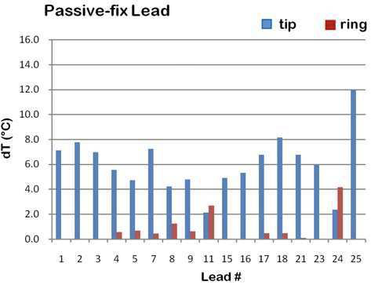
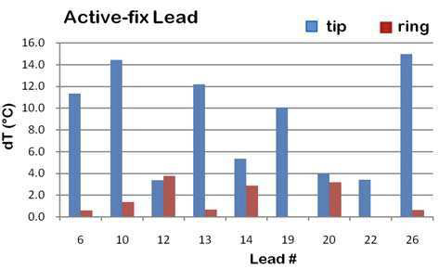
Observations
A significant difference was observed between active and passive fix leads.
The temperature increase for the former was 7.4 C ( active), compared to 4.7C (passive)

Slide 19
Simulation
This simulation was performed to calculate the SAR at different locations of the implant.
This simulation is done at 64 MHz
Software used is Sim4Life
Modified the Tutorial “Generic MRI and LeadPass”
SAR was calculated at the lower region of the body with the implant
Then, the SAR was calculated at the thoracic region with the implant

Slide 20
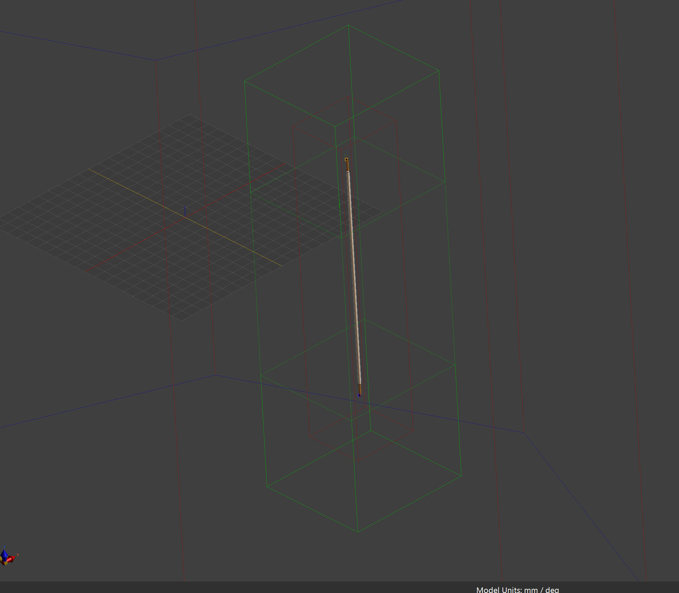
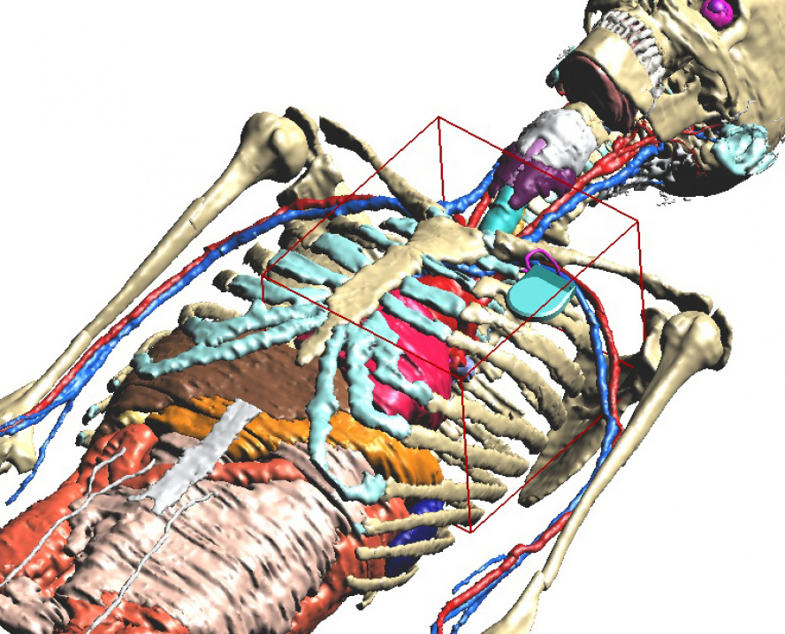
Huygens Source
Lead
Insulator
Wire

Slide 21
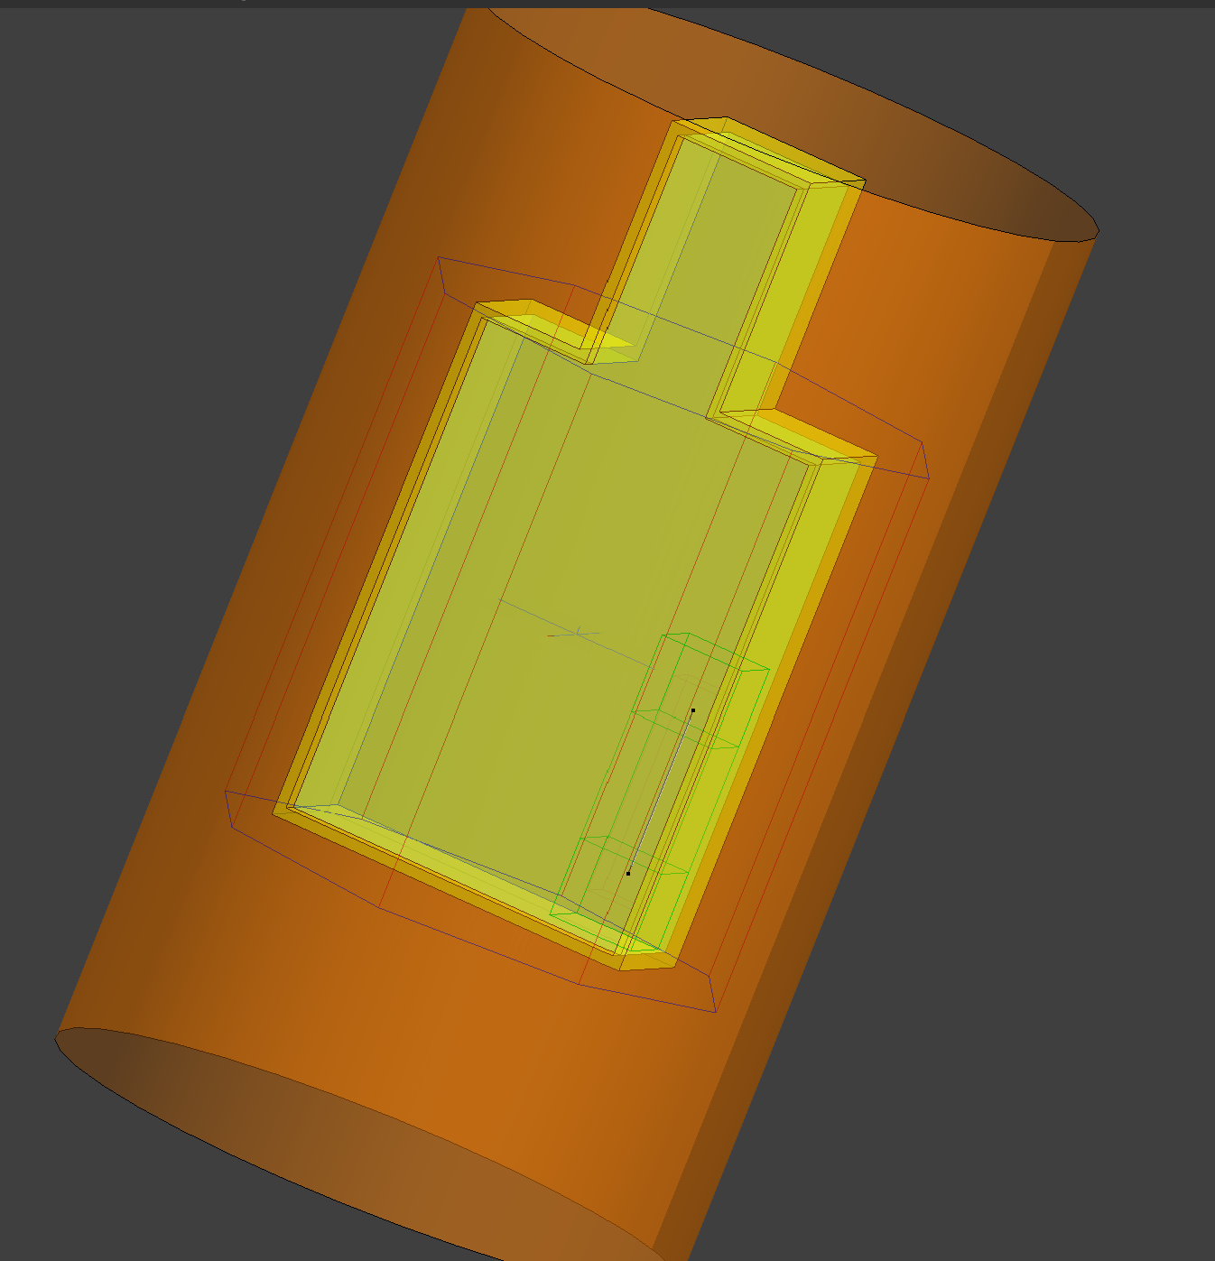
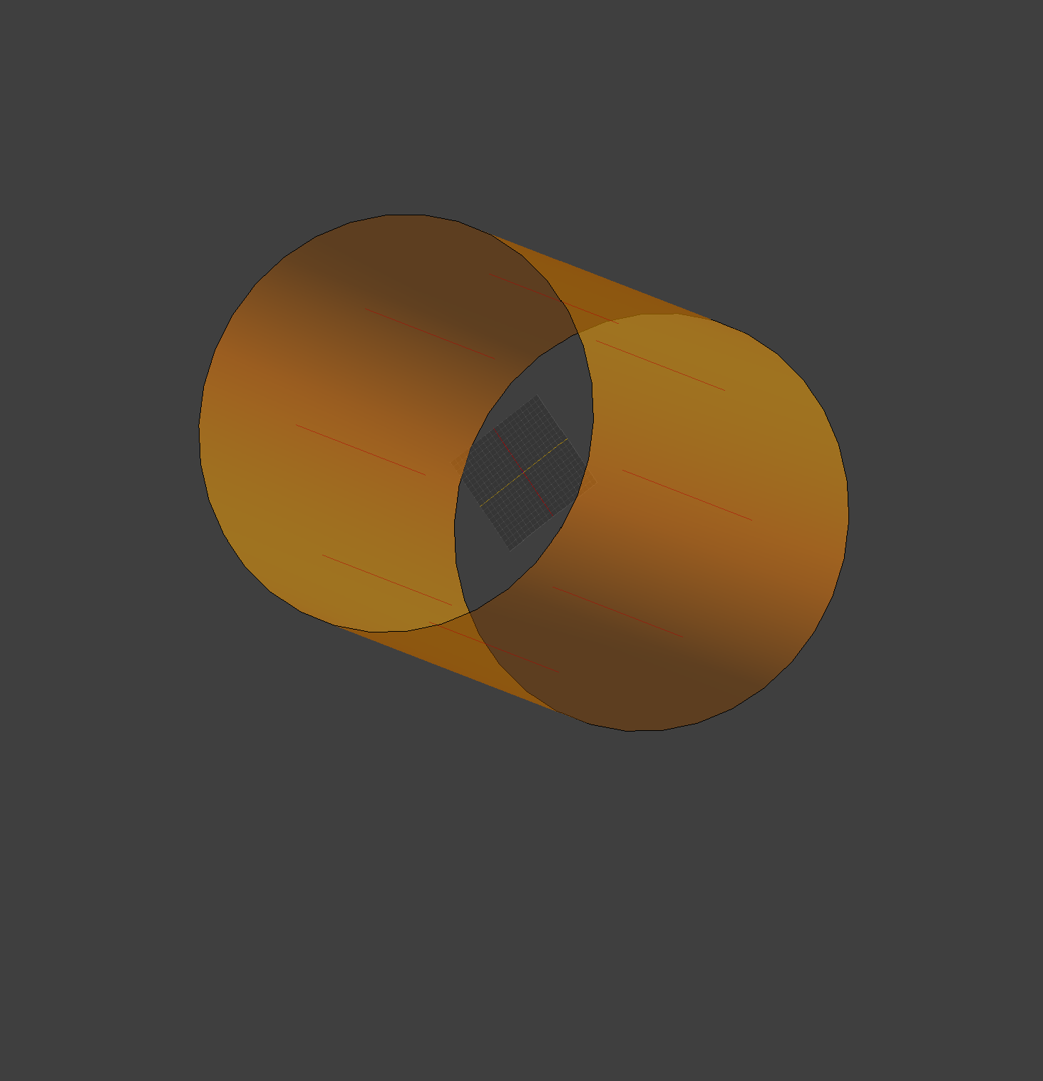
Generic MRI and Lead Pass
And
Shield with lumped elements

Slide 22
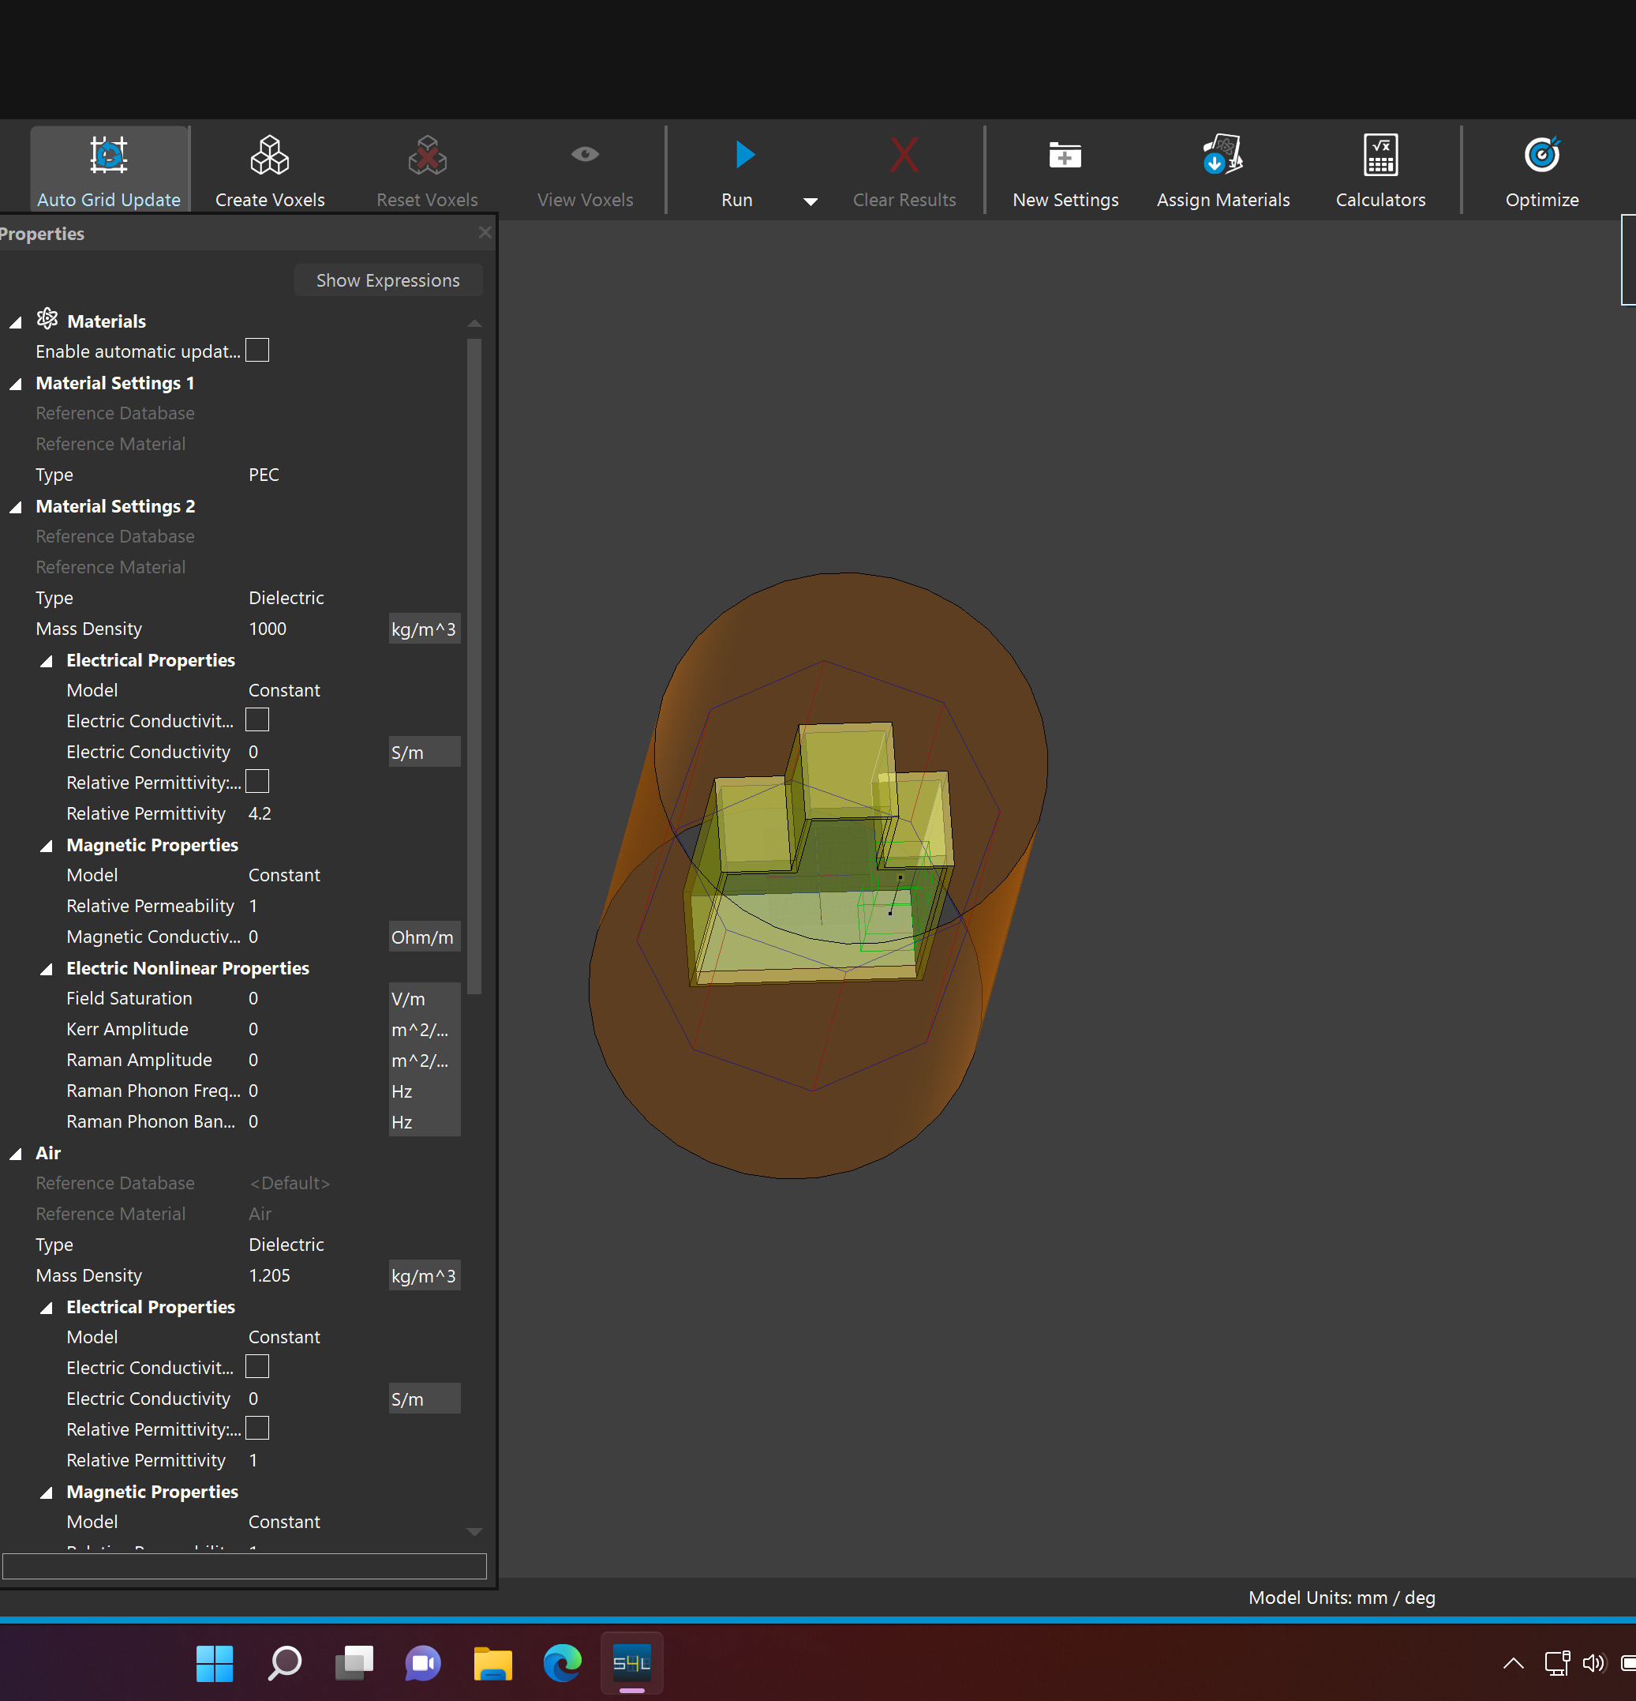
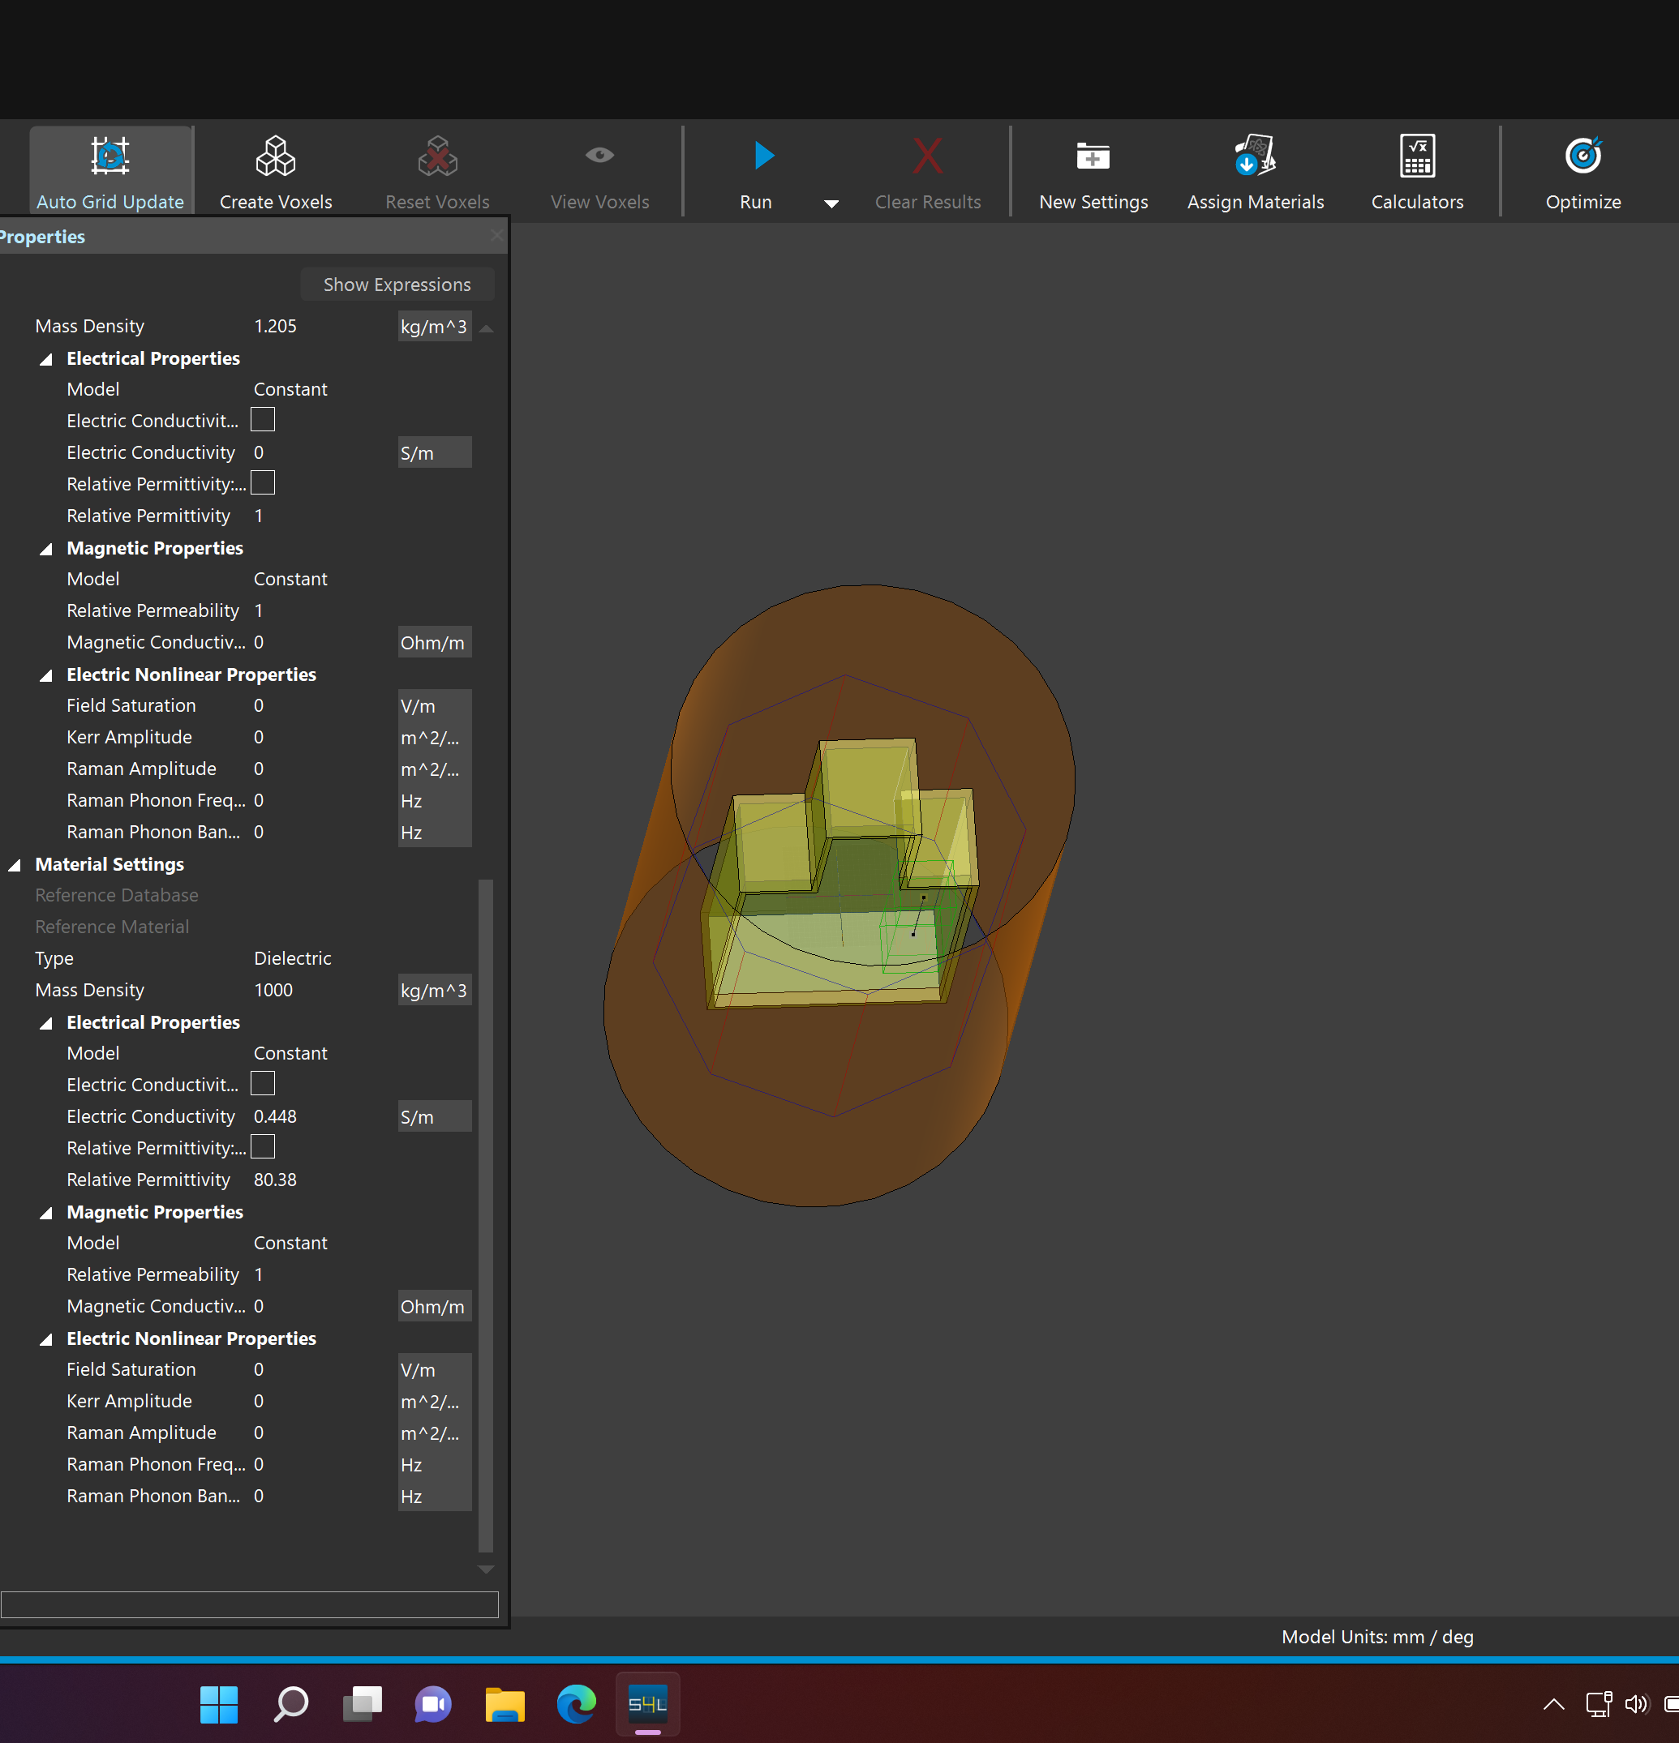

Slide 23
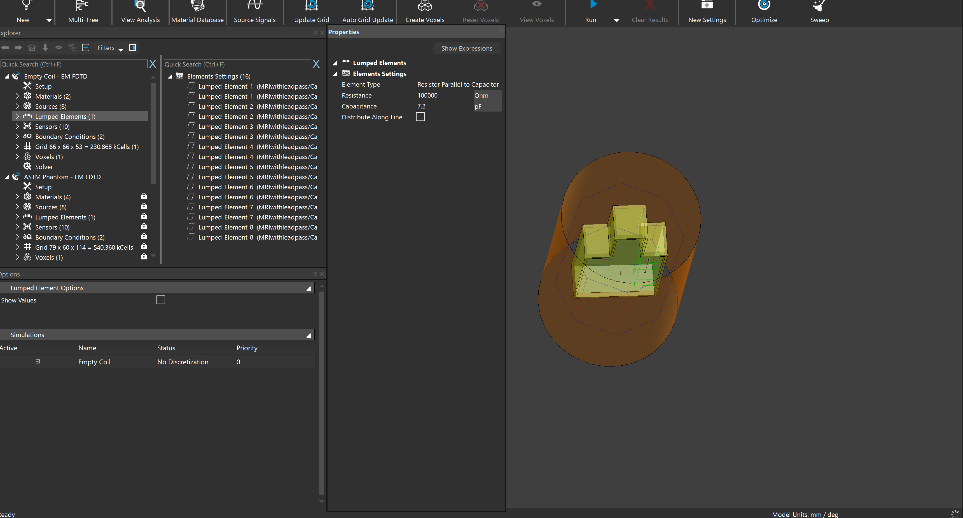

Slide 24
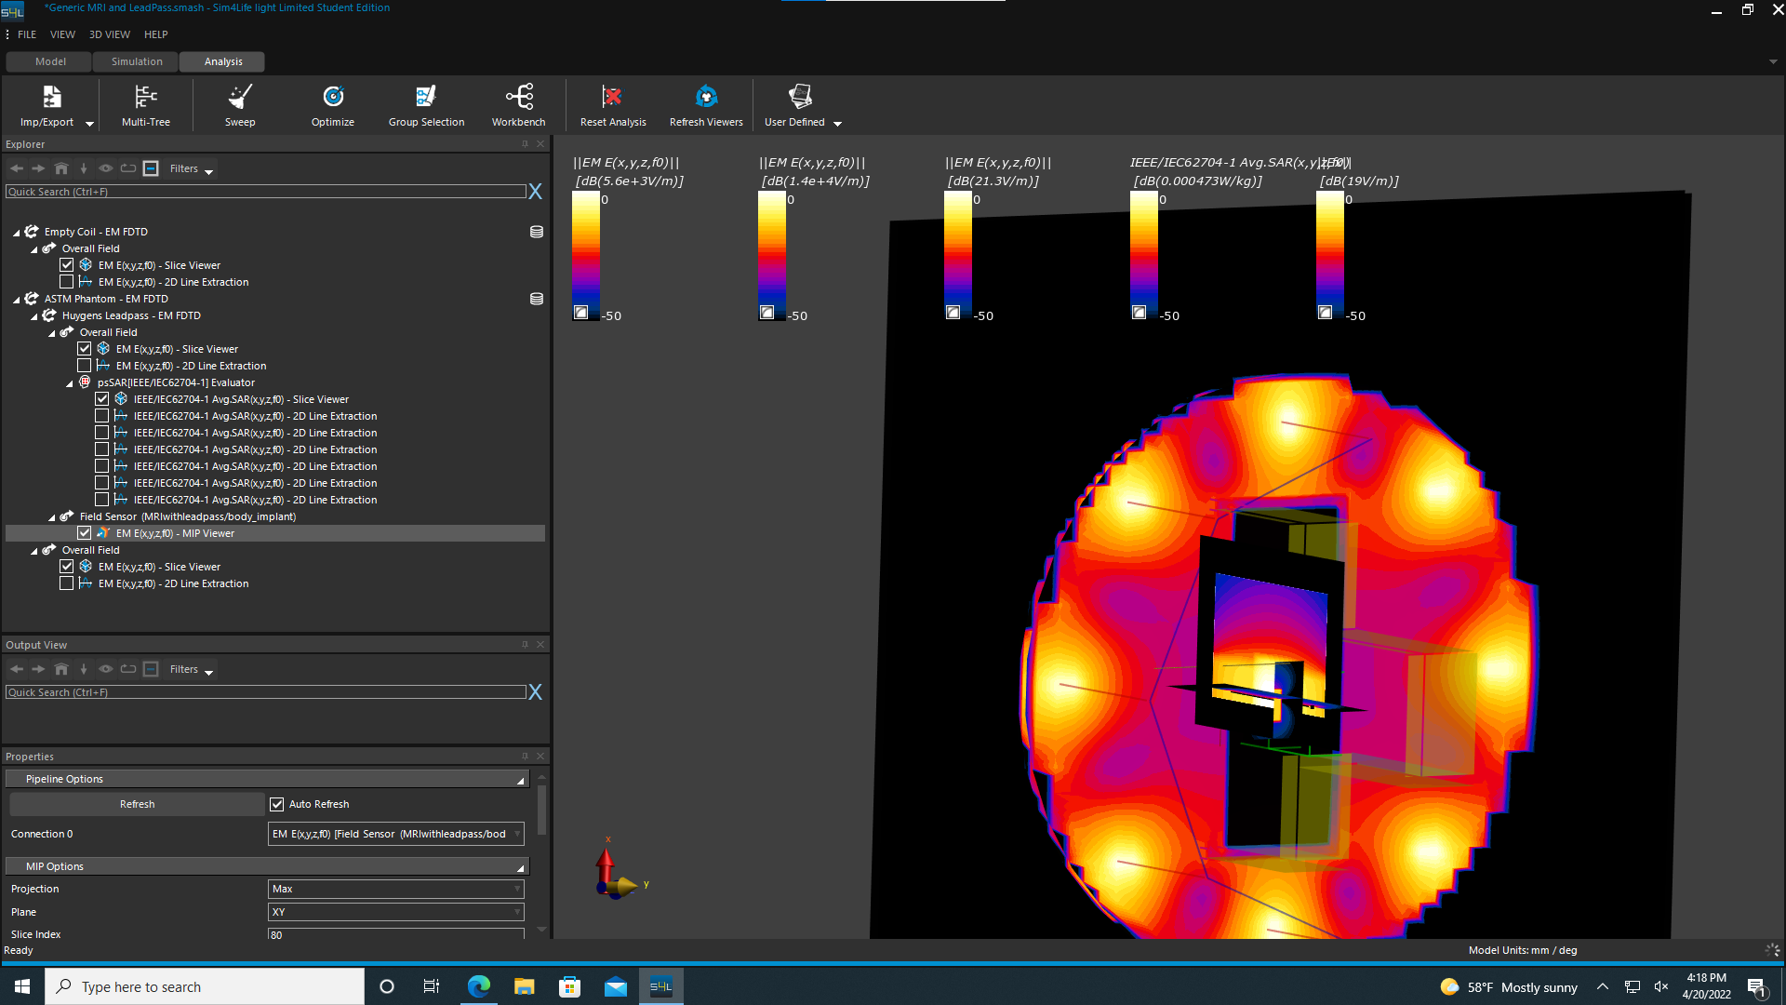
Results ( Modified location)

Slide 25
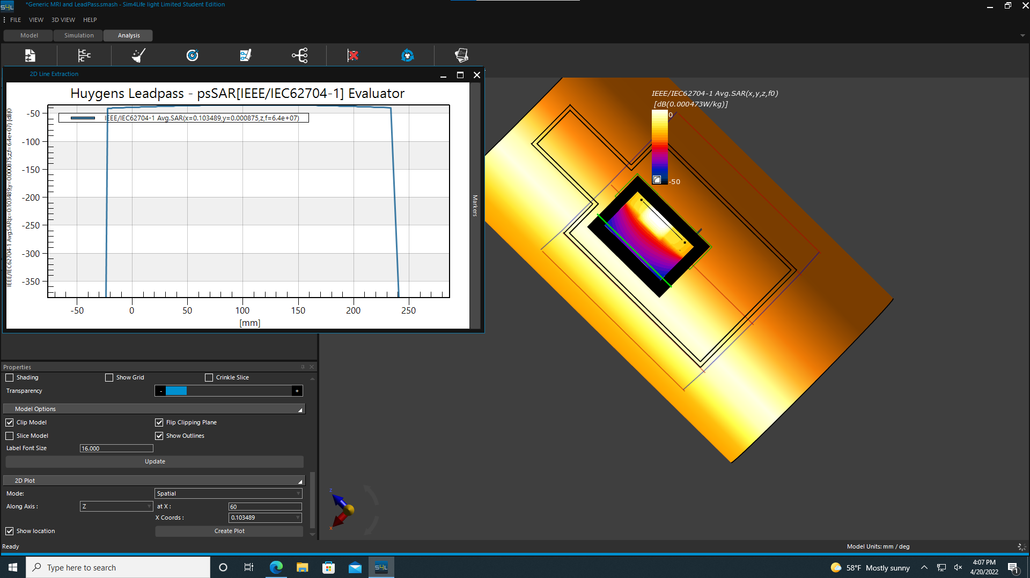


Slide 26
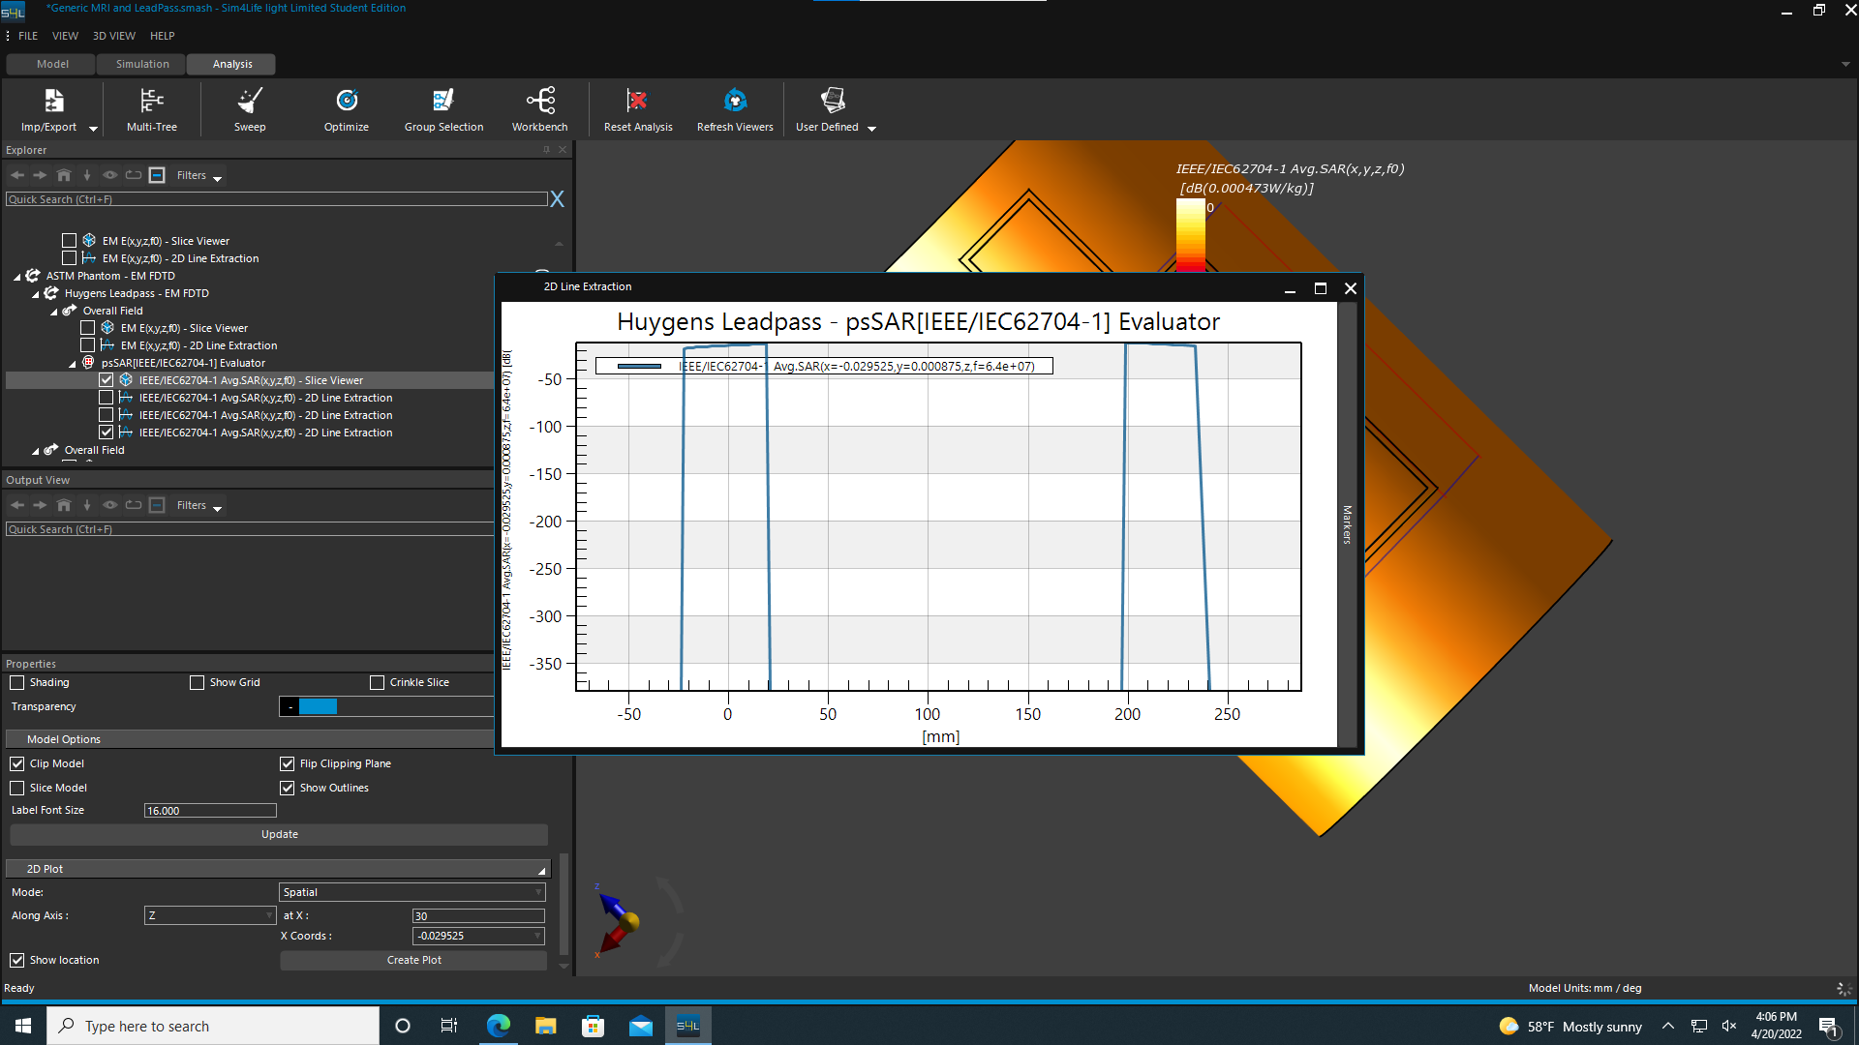

Slide 27
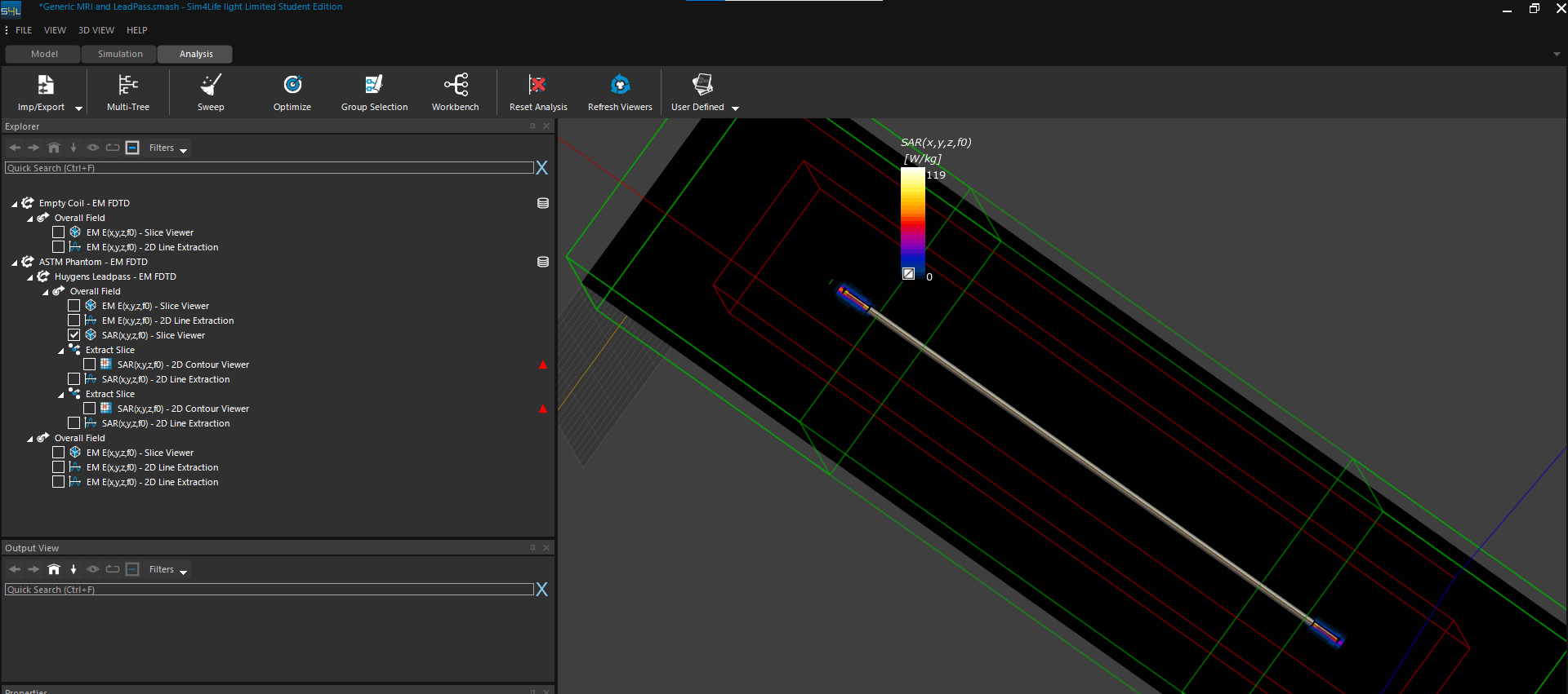
Results (original location)

Slide 28
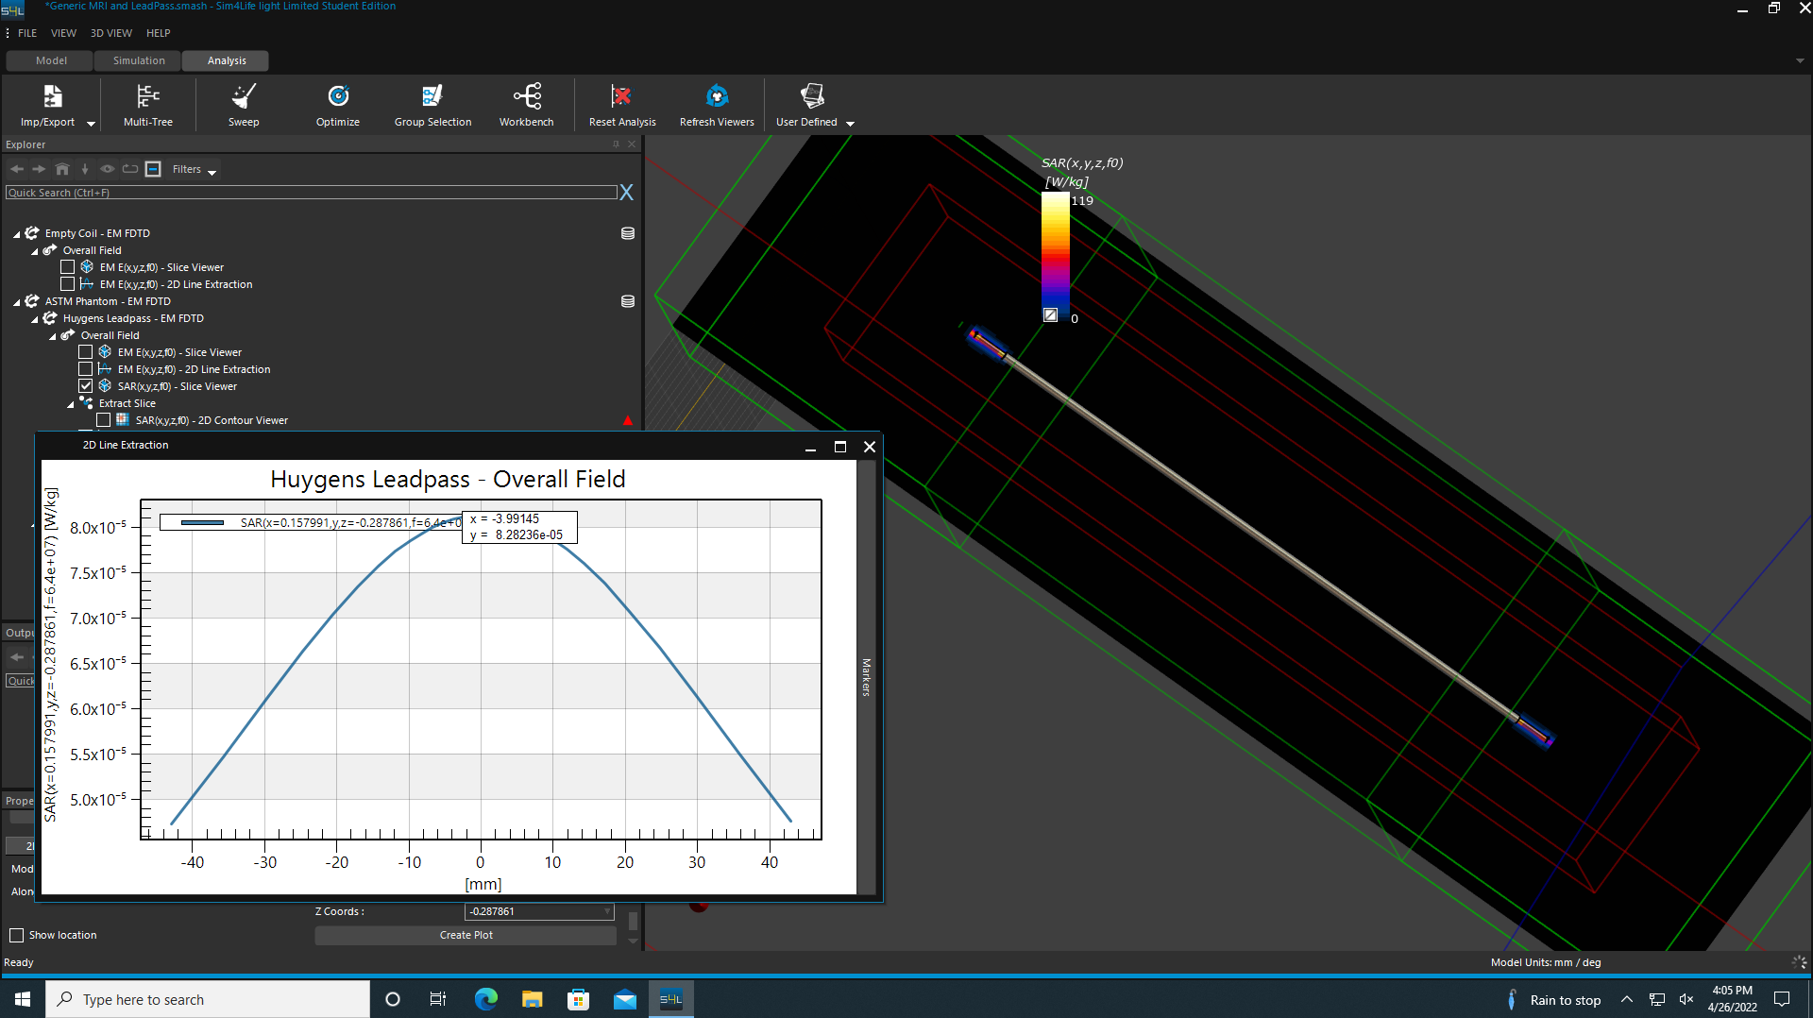

Slide 29
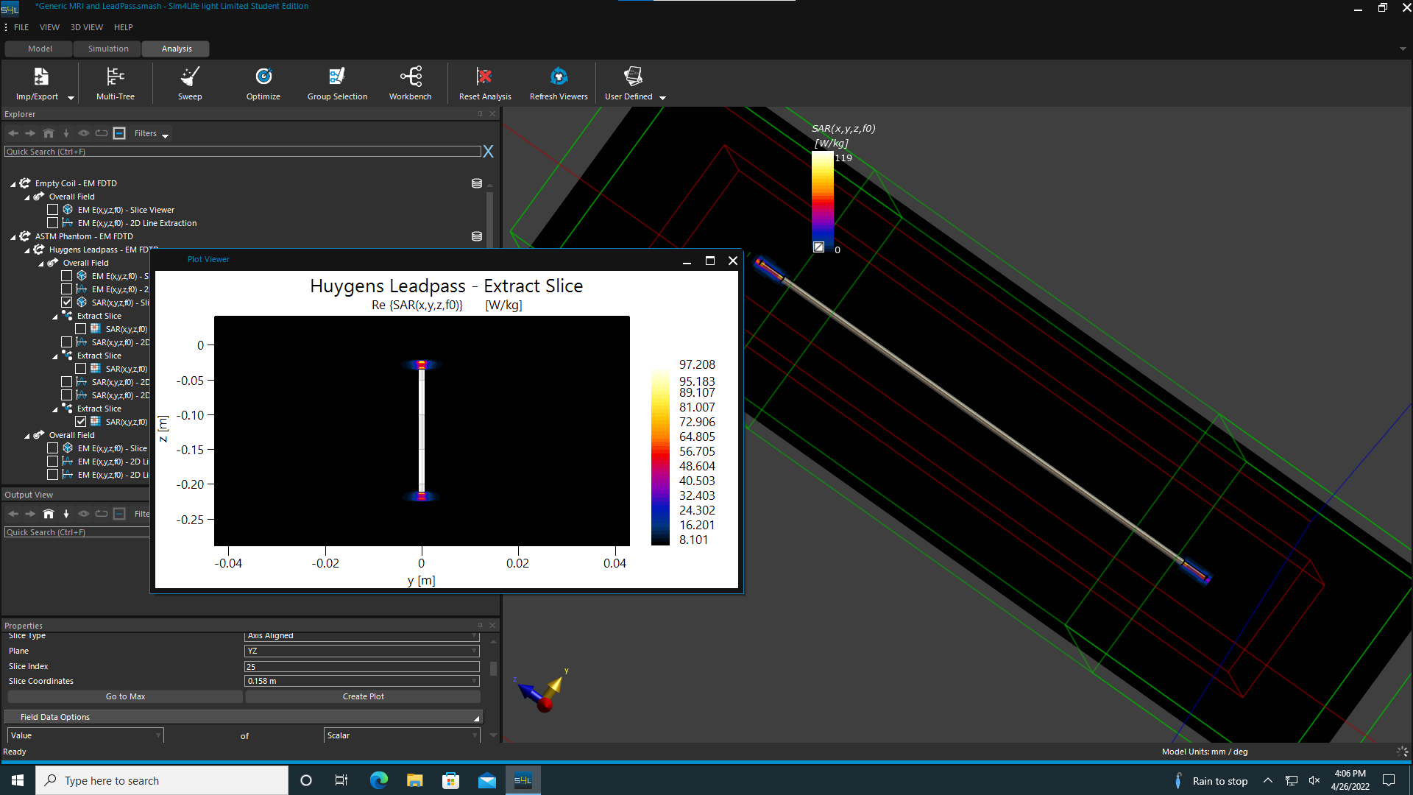

Slide 30

Analysis
There was a difference in SAR in both locations.
When the Huygens Source has modified SAR changes and even with the location.
Maximum SAR is located at the tips of the lead pass.

Slide 31
Safety concerns and Conclusion

